Slide 1
The Worldwide Web of Commercial Surveillance
September 12, 2024

Slide 2
Your devices aren’t listening to you.

Slide 3
They don’t need to, because they already know everything about you.

Slide 4
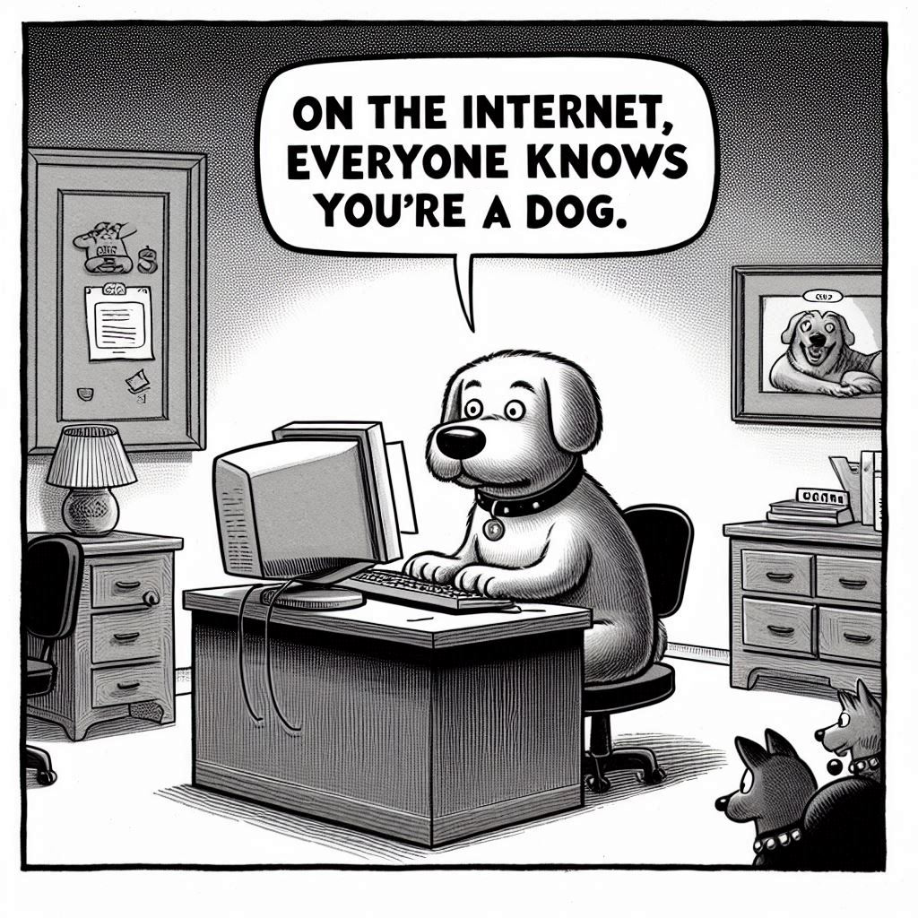
https://designer.microsoft.com/image-creator?p=Create+a+cartoon+in+the+style+of+the+New+Yorker+with+a+%5Bdog%5D+typing+on+a+%5Bcomputer%5D.+The+cartoon+title+is+%22On+the+internet%2C+everyone+knows+you%27re+a+dog.%22&referrer=PromptTemplate

Slide 5
Agenda
Commercial Surveillance Infrastructure(s)
Safety Risks
What to do?

Slide 6
Commercial Surveillance Infrastructure(s)

Slide 7
Topics
It starts with identification
What is identity resolution?
What are Identity Resolution Platforms?
Distributed by design /networked
Company-centric /networked
What are Customer Data Platforms?
Commercial universal identification standards

Slide 8
It starts with identification (aka “identity”).

Slide 9
Powered by Identity & Access Management (IAM) industry
Visible Identification Consumer Involved
Online Accounts
Driver’s License
Powered by Identity Resolution (IRPs) & Customer Data Platforms (CDPs).
Worldwide Web of Commercial Surveillance
Hidden Identification Consumer Uninvolved & Unaware
Adtech & Martech
Fraudtech
Credit
Data Brokers
And by Very Large Online Platforms (VLOPs, 45M users/mo).
Parent companies of VLOPs with many brands and/or products.

Slide 10
What is identity resolution?

Slide 11
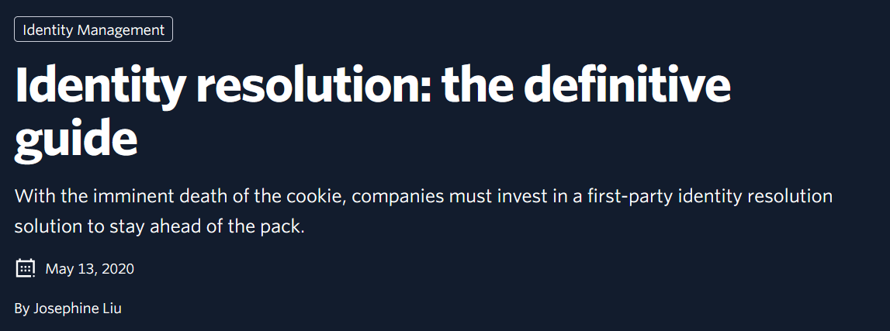
Identity Resolution - In Their Own Words
https://martech.org/what-is-identity-resolution-and-how-are-platforms-adapting-to-privacy-changes/
https://venturebeat.com/ai/what-is-identity-resolution-its-benefits-challenges-and-best-practices/
https://segment.com/blog/identity-resolution/

Slide 12
Identity Resolution
Marketing technology to uniquely identify users across disparate services, devices, and systems.
Enabling audience data as a marketing tool and a sellable data set for:
“Omni-Channel Marketing”
Personalization
New customers

Slide 13
Identity Resolution
Used to confirm User 12345 from LinkedIn as the same person as User 54321 from Facebook.
Used to correlate user 12345 as the:
Owner of Roku device 111111, AND
Owner of iPhone 5555555, AND
Owner of 2023 Toyota Camry VID 999999999, AND
Owner of house at 123 Maple Drive, AND
Holder of California Driver’s license 888888888, AND
Person who bought new running shoes at point-of-sale system 333333 at Runner’s Warehouse on 7/3/24 at 11:33am, AND…..

Slide 14
https://static1.seekingalpha.com/uploads/sa_presentations/953/44953/slides/16.jpg?1565037350

Slide 15
https://claritas.com/wp-content/uploads/2020/06/data-img-2-1.png

Slide 16
Builds an identity graph of all known information about an individual from multiple sources.
Uses:
Deterministic identity matching
Matches email, name, or other join keys
Probabilistic identity matching
Matches based on statistical correlation of data points
“AI” powered
How Identity Resolution Works

Slide 17
Data Collection
Transactional
Bulk transfers
Matching
Deterministic
Probabilistic
Identity Graph
Build / Refine identity graph
Distribute
Query
Share / Sell
Identity Resolution

Slide 18
Ingest data from hundreds to thousands of sources.
Designed to ingest data from multiple sources.
Multiple methods for data ingestion
Big pipes:
APIs (big pipe)
Sync Partners
Customers
Integration Partners
Transactional methods:
Cookies
JS Pixels
Inclusion of universal ID itself in Realtime Bidding protocol.
Data Collection
https://www.vecteezy.com/free-vector/magic-background Magic Background Vectors by Vecteezy

Slide 19
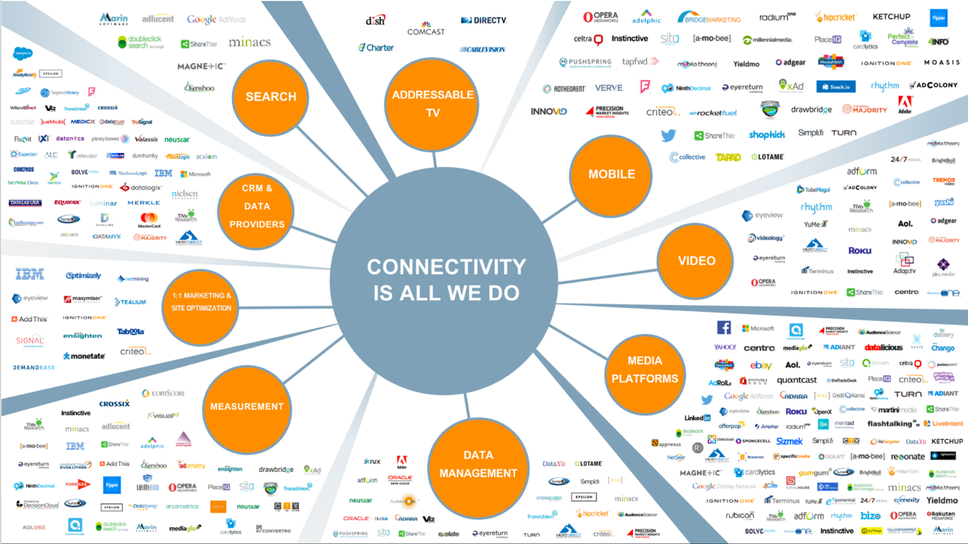
https://docs.liveramp.com/connect/en/image/uuid-fabcb871-4289-b364-1f23-adfef7086887.png

Slide 20
Matching
Resolves multiple identities to a single identity.
Resolves local identification schemes to a proprietary universal identification scheme.

Slide 21
Let’s get geeky….

Slide 22
Scope of Identification Schemas
Local Identification Schemas
Universal Identification Schemas
Identity and Access Management Industry
Identity Resolution & Customer Data Platform Industries
Used for Visible Identification
1st Party / Data Controller
Responsible for legal bases for data processing
Some 1st parties are so large as to be nearly universal (e.g. Facebook with 3.07B users—38% of all people on the planet)
And Google (we’ll come back to Google)
Used for Hidden Identification
3rd Parties, Joint Controllers?
Incredibly valuable datasets
Relies on 1st parties for legal bases for data processing
Maps local identification numbering schemas to universal identification numbering schemas

Slide 23
RampID Universal ID
Partner2 IDs
Partner3 IDs
Local Identification Schemas
Partner4 IDs
Universal Identification Schema
Partner1 IDs
RampIDs
Partner10 IDs
Partner5 IDs
Partner9 IDs
Partner6 IDs
Partner8 IDs
Partner7 IDs

Slide 24
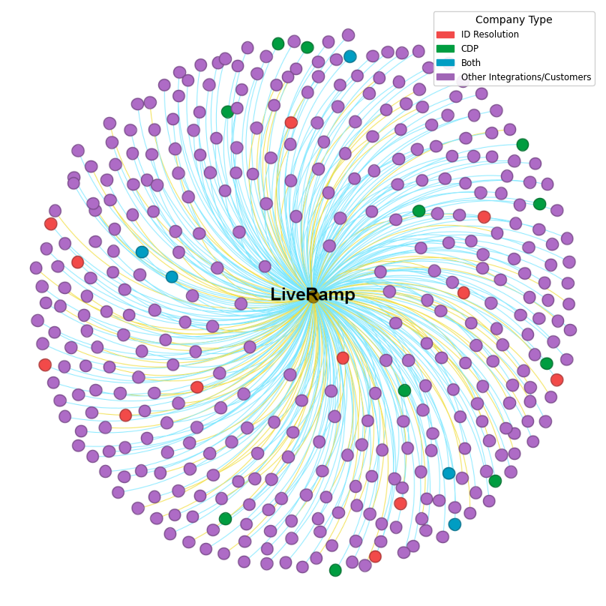
Data Broker Behavior
You are using this service

Slide 25
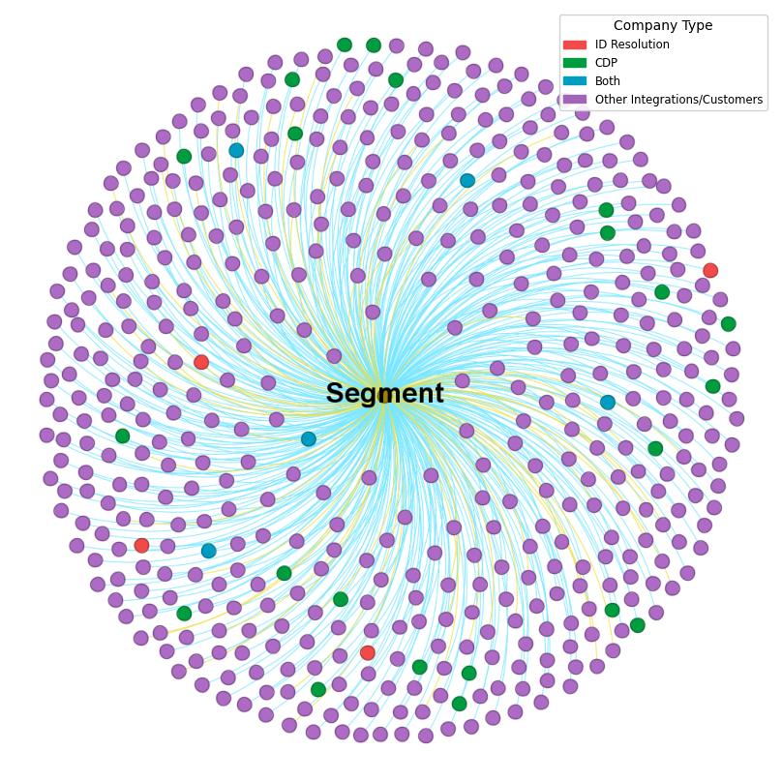
Non-Data Broker Behavior
You are using this service

Slide 26
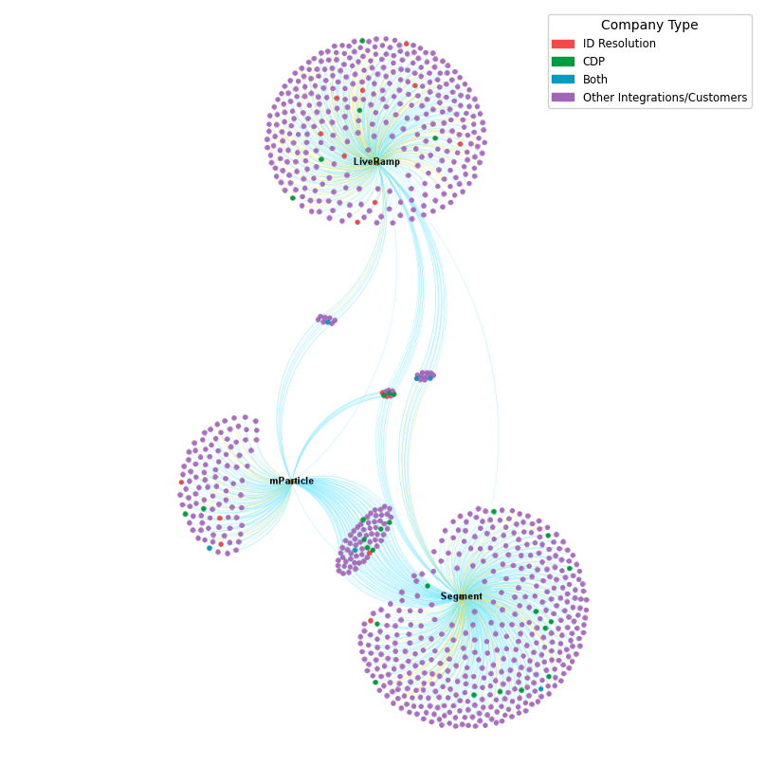

Slide 27
Identity Resolution platforms
resolve
multiple identifiers to a universal identifier for a specific person in the world.

Slide 28
Identity Resolution platforms
resolve
multiple identifiers AND PERSONAL INFORMATION to a universal identifier for a specific person in the world.

Slide 29
What are Customer Data Platforms?

Slide 30
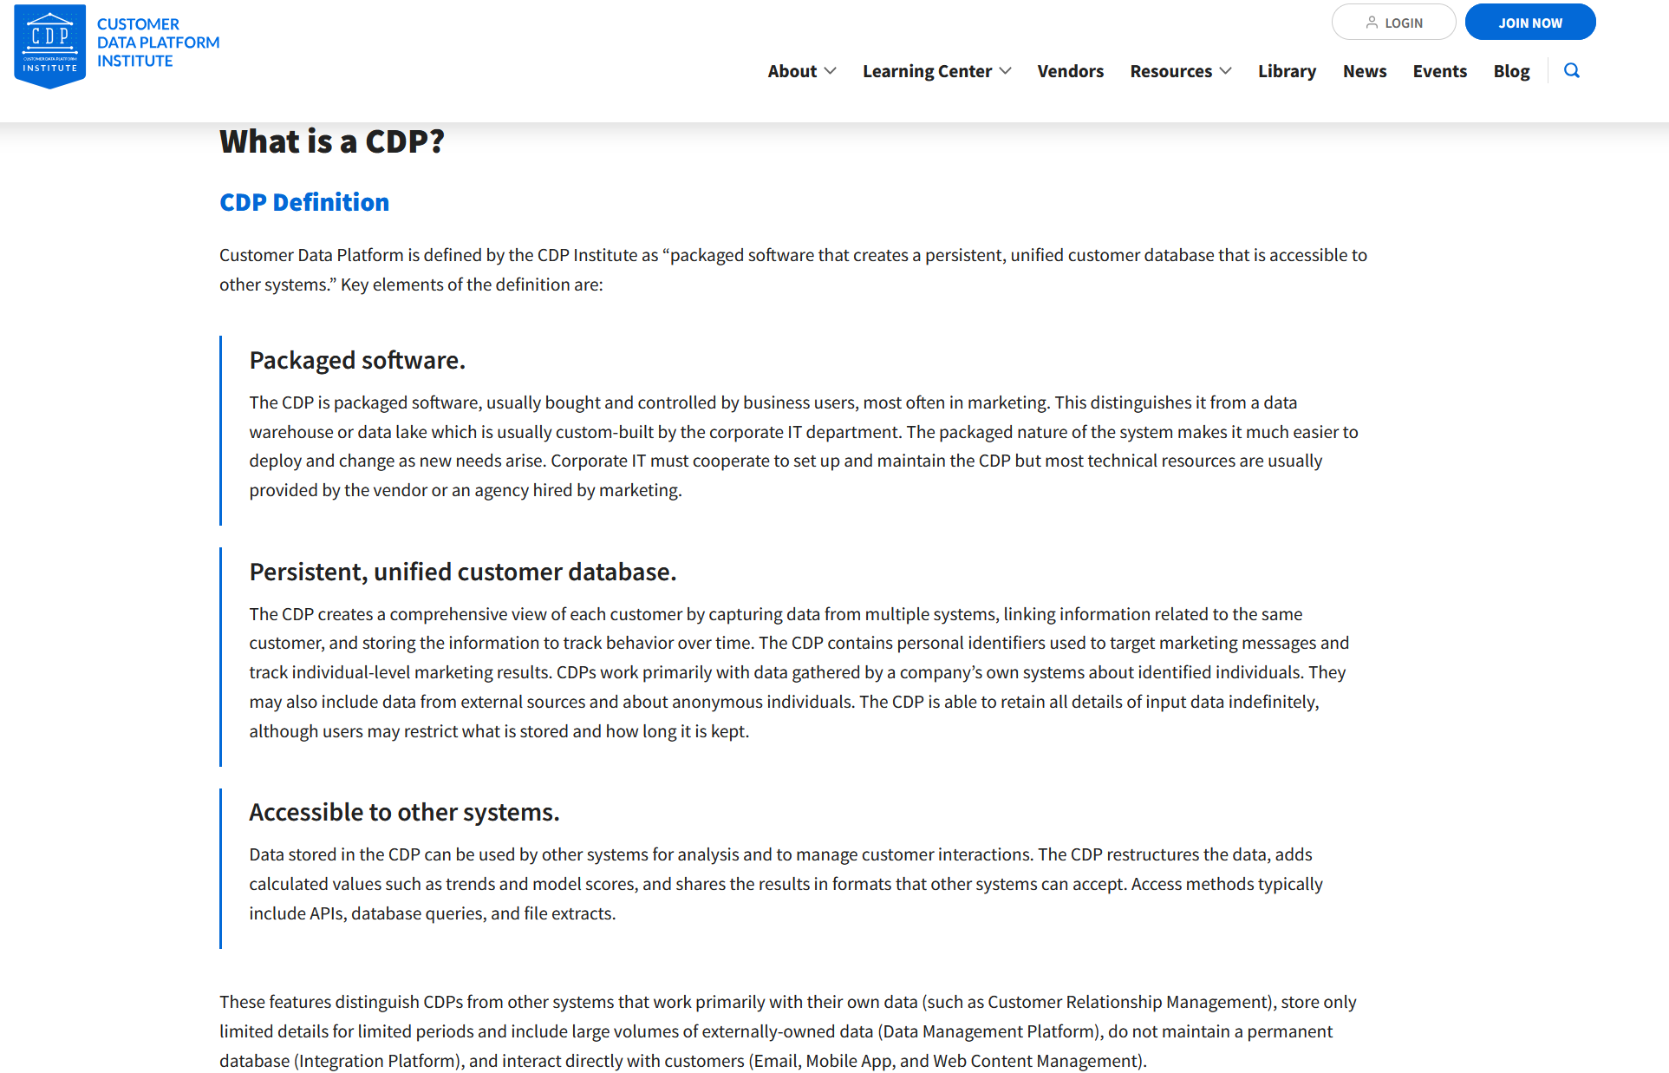
Requires persistent, universal customer identifiers→ Identity Resolution.
https://www.cdpinstitute.org/learning-center/what-is-a-cdp/#section1

Slide 31
Similarly, identity resolution platforms need personal information
to work.
Robert Fornal, https://www.flickr.com/photos/fornal/373418814/

Slide 32
Both are pervasively used for marketing purposes
But not exclusively.
Identity Resolution is used by many industries.
The information allows companies to “know” digital users at all times.
For fraud detection,
For personalization (which EVERYONE wants),
For customer prospecting,
For general customer relationship management.
Mature industries (>10yo)
Universal ID
Common Characteristics of ID Res and CDPs

Slide 33
Both are highly interconnected
Designed to ingest data from multiple sources.
Multiple methods for data ingestion
Two variants of Identity Resolution
Distributed by design -> no 1st party relationships
Company-centric -> multiple brands/products
Universal ID
Common Characteristics of ID Res and CDPs (cont’d)

Slide 34
Company-Centric
Identity Resolution

Slide 35
VLOPs have so many users that they are essentially a universal identification schema.
In addition to one or more VLOPs, some companies have so many products that they perform cross-product identity resolution internally.
Google’s GAIA
Worlds Unto Themselves (kind of)

Slide 36
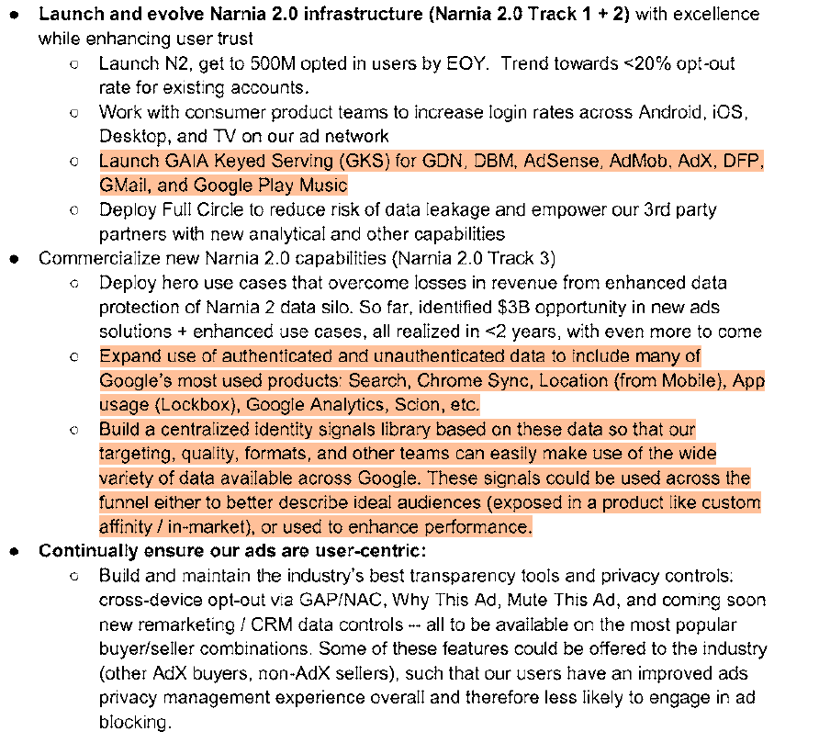
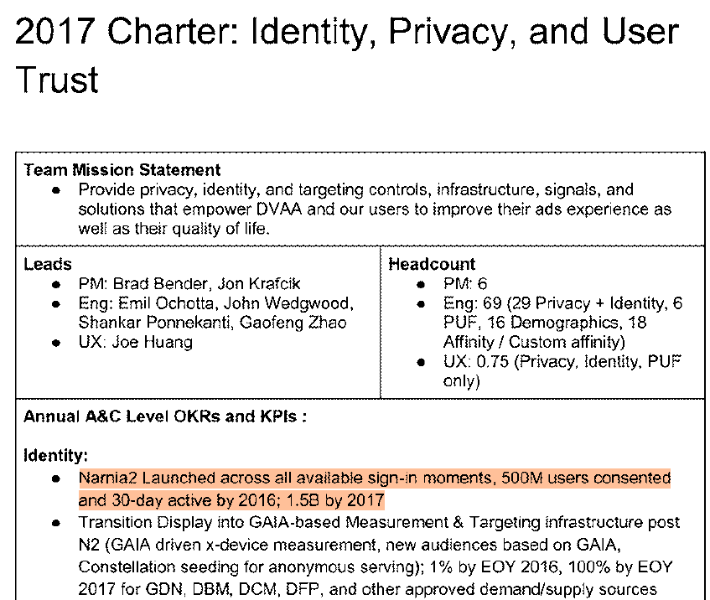
Pp 126, 200, 202: https://storage.courtlistener.com/recap/gov.uscourts.vaed.533508/gov.uscourts.vaed.533508.1132.2_1.pdf

Slide 37
Universal
Customer Identification Standards

Slide 38
Unified ID 2.0 https://unifiedid.com/
European Unified ID https://euid.eu
Led by identity resolution and CDP companies.
Universal Customer Identification Standards

Slide 39
Safety Risks

Slide 40
Risks
Always tracked, regardless of being logged in, and data shared with data brokers.

Slide 41
ISL Safe Software Principle #3: Identification Minimization
“Any kind of identification performed must be proportional to the particular Me2B Commitment. Thus, the software must collect only the minimum set of identity attributes necessary to uniquely identify an individual as needed for the particular Me2B Commitment.”

Slide 42
Digital Me2B Relationships
Legend
= Me2B Commitment
Account Creation / Use
Sign up for Loyalty Program
Buildup
Deterioration
Sign up for Promotional Communications
Acquaintance
One-off Transaction
Termination
Accept Cookies
Location Consent
Close Account
Anonymous
Recognized
Known
Anonymous
Logged In State
Notes:
A fundamental aspect of the ISL software safety standards is the state of the digital me2b relationship that the individual is having with the maker of technology as mediated by the technology itself. This model emulates real world interpersonal relationships—it is an idealized model, even for personal relationships. But the point is that the relationship develops over time, starting from a point of anonymity and peaking at a point where the individual decides to create an account and use the service while logged in. Generally, we think people have a reasonable expectation to only be known while in the logged in state. This is in fact not at all the case, as we’ll see, due to the prevalence of the hidden identification infrastructures.

Slide 43
Digital Me2B Relationship - REALITY
Legend
= Me2B Commitment
Account Creation / Use
Known
Sign up for Loyalty Program
Buildup
Deterioration
Sign up for Promotional Communications
Acquaintance
One-off Transaction
Termination
Accept Cookies
Location Consent
Close Account
Logged In State
Notes:
The reality of the Me2B Relationship is more accurately this: a state of constant being recognized, remembered and personally responded to.

Slide 44
30.1% of IRPs
are data brokers.
https://internetsafetylabs.org/resources/references/identity-resolution-and-customer-data-platform-companies/

Slide 45
7.4% of CDPs
are data brokers.

Slide 46
Risks
Always tracked, regardless of being logged in, and data shared with data brokers.
Lack of disclosure + unpredictable behavior of system = not knowable, not consentable¹
¹ “Is it possible to validly consent to the proposed activity?”
Kim, Nancy S.. Consentability: Consent and its Limits (p. 49). Cambridge University Press. Kindle Edition.

Slide 47
“…and we share your data with our marketing partners.”

Slide 48
Data Broker Behavior
You are using this service

Slide 50
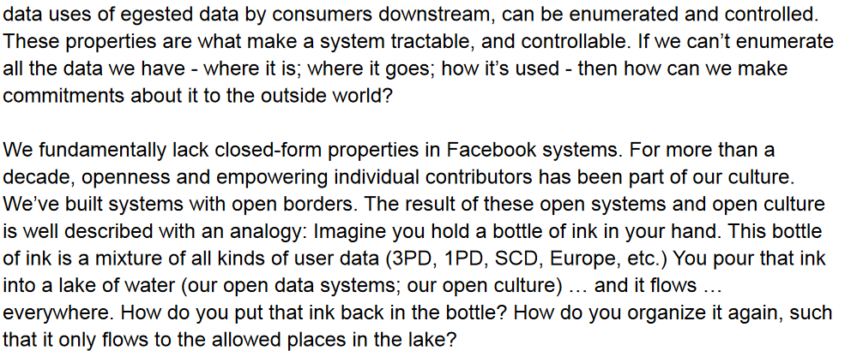
https://www.vice.com/en/article/akvmke/facebook-doesnt-know-what-it-does-with-your-data-or-where-it-goes
https://s3.documentcloud.org/documents/21716382/facebook-data-lineage-internal-document.pdf

Slide 51
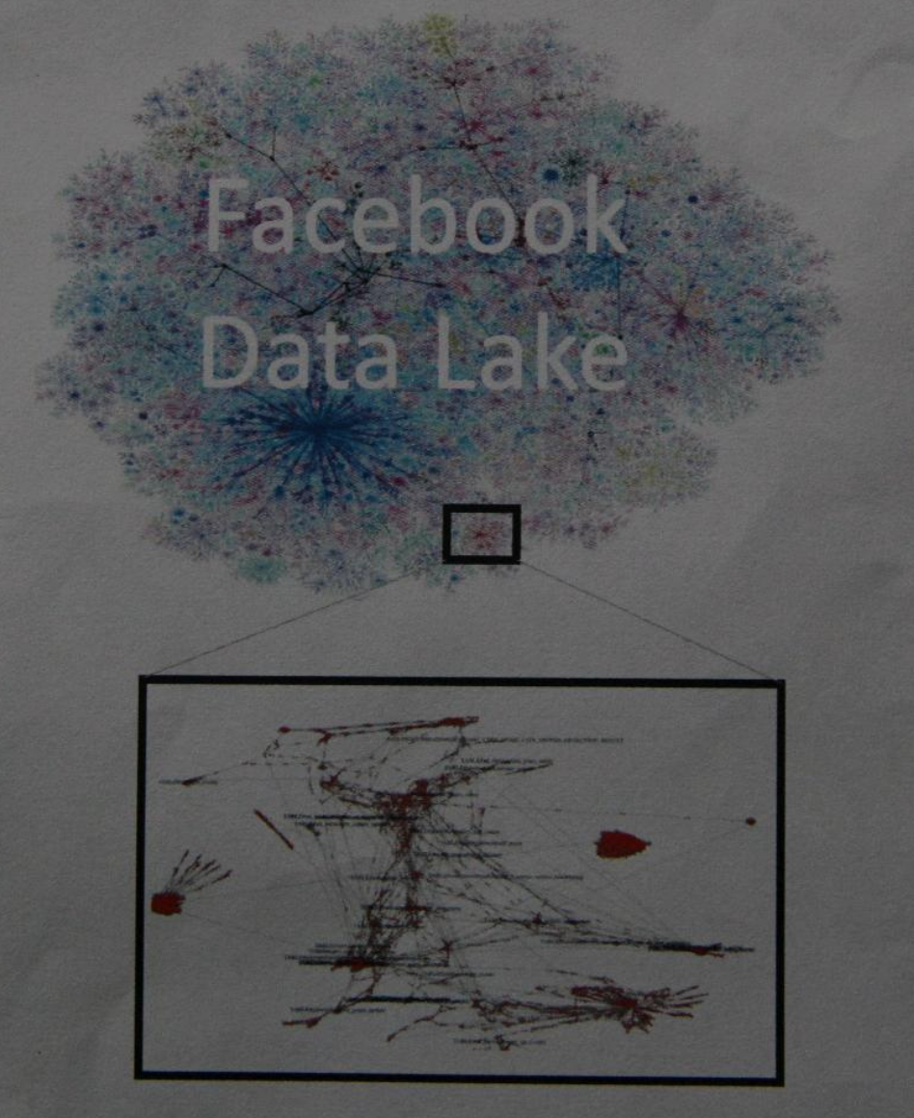
https://s3.documentcloud.org/documents/21716382/facebook-data-lineage-internal-document.pdf

Slide 52
Risks
Always tracked, regardless of being logged in, and data shared with data brokers.
Lack of disclosure + unpredictable behavior of system = not knowable, not consentable¹
Massive scale
¹ “Is it possible to validly consent to the proposed activity?”
Kim, Nancy S.. Consentability: Consent and its Limits (p. 49). Cambridge University Press. Kindle Edition.

Slide 53
Risks
Always tracked, regardless of being logged in, and data shared with data brokers.
Lack of disclosure + unpredictable behavior of system = not knowable, not consentable¹
Massive scale
Unstoppable
¹ “Is it possible to validly consent to the proposed activity?”
Kim, Nancy S.. Consentability: Consent and its Limits (p. 49). Cambridge University Press. Kindle Edition.

Slide 54
Industries Benefitting from Hidden Identification
Industries who want to increase certainty and reduce risk
Insurance
Government / Law Enforcement
Finance
Fraud
Industries who want to influence consumers
CRM
Advertising
Marketing
Industries who amass information as a core business
Social Networks
Academic Research
Legal Research & Publication
Hidden Identification Enabling Industries
Identity Resolution Platforms (ID Res)
Customer Data Platforms (CDP)
$8.9T

Slide 55
Risks
Always tracked, regardless of being logged in, and data shared with data brokers.
Lack of disclosure + unpredictable behavior of system = not knowable, not consentable¹
Unstoppable
Loss of autonomy
¹ “Is it possible to validly consent to the proposed activity?”
Kim, Nancy S.. Consentability: Consent and its Limits (p. 49). Cambridge University Press. Kindle Edition.

Slide 56
Risks
Always tracked, regardless of being logged in, and data shared with data brokers.
Lack of disclosure + unpredictable behavior of system = not knowable, not consentable¹
Unstoppable
Loss of autonomy
Indiscriminate data collection
¹ “Is it possible to validly consent to the proposed activity?”
Kim, Nancy S.. Consentability: Consent and its Limits (p. 49). Cambridge University Press. Kindle Edition.

Slide 57
Analysis of over 1200 EdTech apps.
In total, 539 apps were observed sending data to ID Res or CDP entities.
We found outbound network traffic to:
37 Identity Resolution Platforms (12 data brokers)
LiveRamp, The Trade Desk, Transunion, Criteo, ID5, Neustar
38 Customer Data Platforms (5 data brokers)
Oracle, Piano, Microsoft, Salesforce, Klaviyo
66 unique orgs, either Identity Resolution, Customer Data Platform or both.
9 orgs appear in both categories.
Segment, Tealium, Treasure Data, mParticle, Epsilon
These are apps recommended or required by schools for children as young as pre-K.
ISL 2022 K-12 EdTech App Safety Benchmark

Slide 58
Retested 43 of the worst offenders.
86% were better.
Why??
App Retesting

Slide 59
What To Do?

Slide 60
Education and transparency
Policy-makers should be talking about these platforms and technologies
Retesting apps to better assess magnitude and risks
Adding Identity Resolution and CDP traffic flows in App Microscope.
What We’re Doing

Slide 61
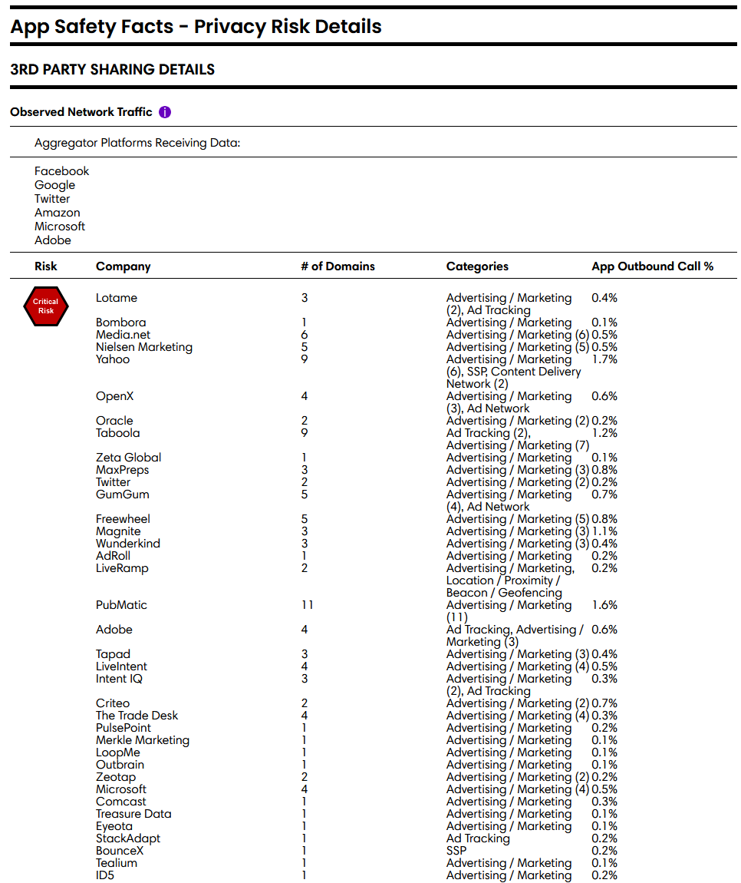
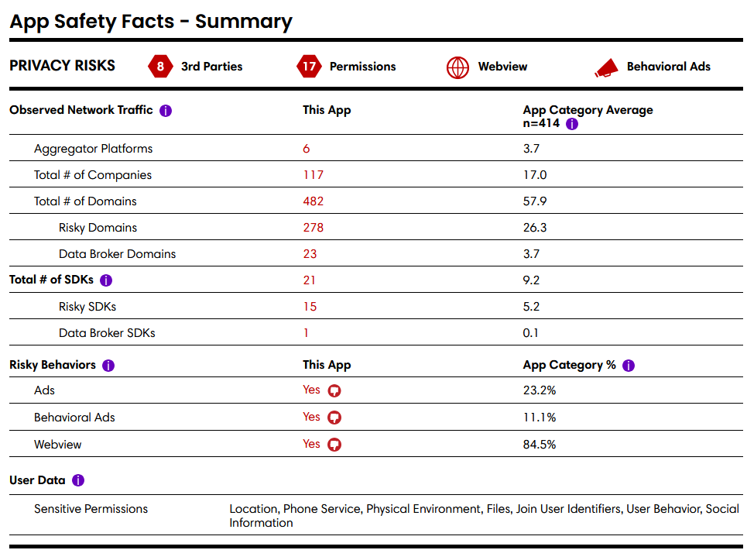
https://appmicroscope.org/app/1579/
Observed Data Sharing
Notes:
One of the key tools we developed to publish the findings of our research is App Microscope, a freely available tool where people can view safety labels for all the apps in the benchmark (and beyond). Our safety labels are modularly designed, and present privacy risk information, starting with headline data including the app score, moving into summary safety facts, and finally moving into detailed privacy risk data. The key part I want to focus on today is the Observed Data Sharing risks in the label. The label you’r looking at is the worst/riskiest label in the sample. Starting with the summary data on the left side of the screen, you can see that this app shared data with 117 3rd parties when we tested it in 2022, which is much higher than the category average of 17 companies. (note that this category of apps is among the riskiest/leakiest. Note also that the app shared student data with 23 data broker domains. The right side of the label shows the details of the subdomains found in the network traffic sorted into 4 risk levels, and organized by the company who owns the subdomain. You can see that all of these domains are advertising and marketing related.

Slide 62
ISL Resources
Identity Resolution and CDP database
https://internetsafetylabs.org/resources/references/identity-resolution-and-customer-data-platform-companies/
Identity Resolution and CDPs in 2022 Benchmark
https://internetsafetylabs.org/resources/references/identity-resolution-and-customer-data-platforms-found-in-2022-edtech-benchmark-network-traffic/
Report
https://internetsafetylabs.org/resources/reports/the-worldwide-web-of-human-surveillance-identity-resolution-customer-data-platforms/

Slide 63
What You Can Do
As a User of Technology
As a Maker of Technology
Turn privacy settings to 11.
Disable/reject cookies.
Disable advertising IDs.
Use ad blockers.
Request your data to be removed.
Be vocal.
Do you minimize identification?
Are you using invisible identification?
(Most brands do, for marketing.)
What for? Is it necessary?
Know the risks of indiscriminate data collection/user identification.
Do your users know/understand this? Are you sure?
Be curious and vocal.

Slide 64
Knowing it’s happening and knowing how it’s happening at massive scale are two different things.
Makers of hidden identification infrastructure have tremendous power through personal data and universal identification.
These platforms demand special attention (ala VLOSEs and VLOPs).
More oversight and governance is needed for these platforms.
Data broker laws woefully inadequate.
Nihil de nobis, sine nobis (Nothing about us, without us.)
Data brokers must register all sources of data.
Remove 3rd party constraint.
What can we do together?
Summary

Slide 65
What can we do together?

Slide 66
Thank You!

